Slide 1

Friends & Family Restaurant
Mini Project-Website
Mentor: Mr. Mandeep Singh
Group members:
Arvind Jaiswal
Satyam Singh
Umesh Pratap Singh
Vipul

Slide 2
OBJECTIVE
The main objective of this project is to create a Restaurant Website for Advertisement and ecommere.
In this Website the user will have all the menu dislayed and he can make table reservation and can order food as well . Also the website contains some glimpse of Restaurant’s Hospitality and also they can give their valuable feedbacks.

Slide 3
MOTIVATION
As the world is moving forward in the digital era most of the people do no prefer waiting a long for anything ,also they are more inclined towards getting things at their door. Hence getting restaurant facility at fingertips would be a great thing to improve their comfort.
The goal of the website is to provide a digital contact and support medium to our customers and to provide facilites at their finger tips.

Slide 4
TECHNOLOGY AND TOOLS USED
HTML5
CSS3
Bootstrap4
JavaScript
Github
Visual Studio Code

Slide 5
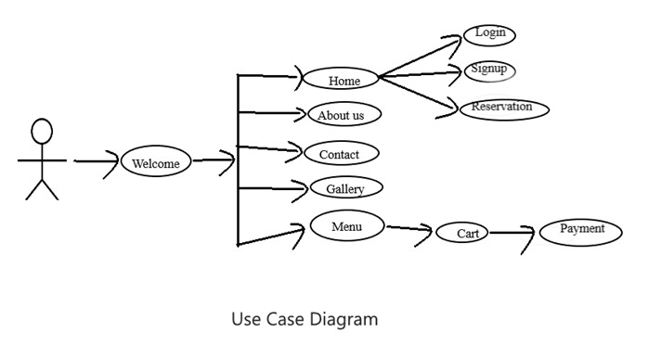
USE CASE DIAGRAM

Slide 6
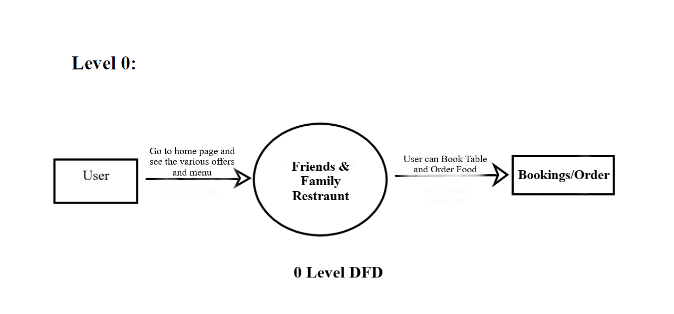
ZERO LEVEL DFD

Slide 7
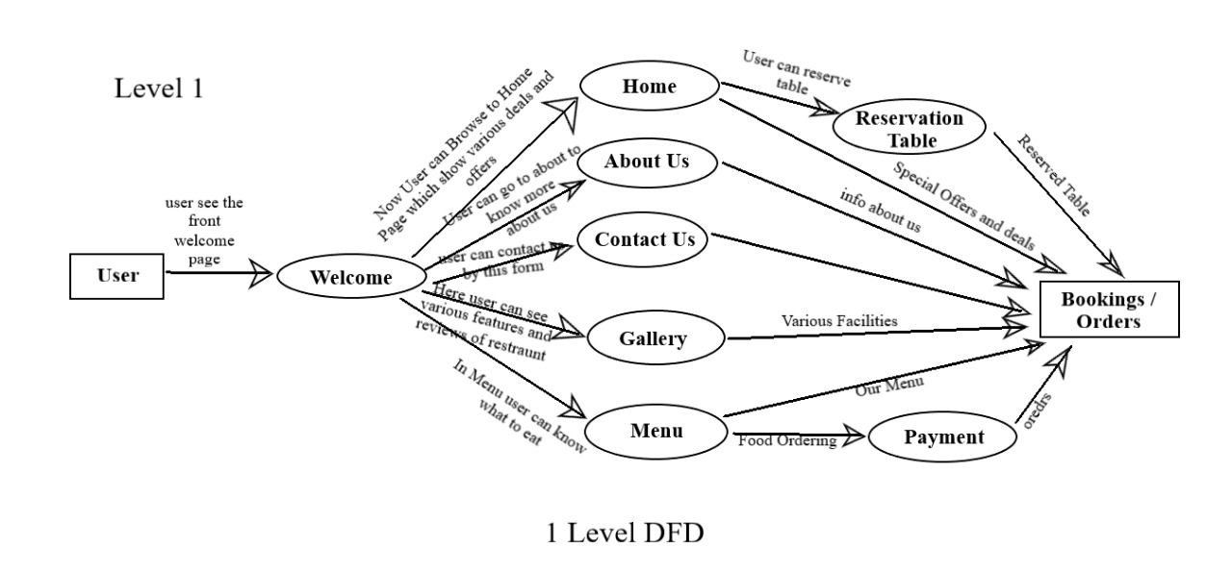
LEVEL 1 DFD

Slide 8
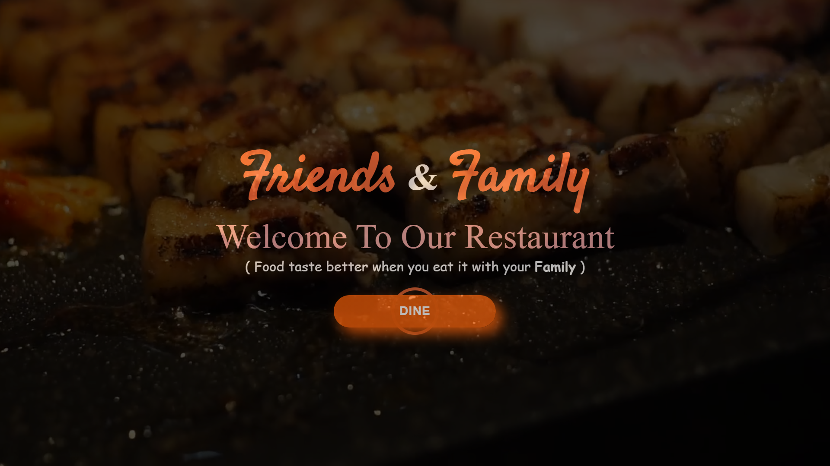
LANDING PAGE
This is the page first webpage that the user will see.

Slide 9
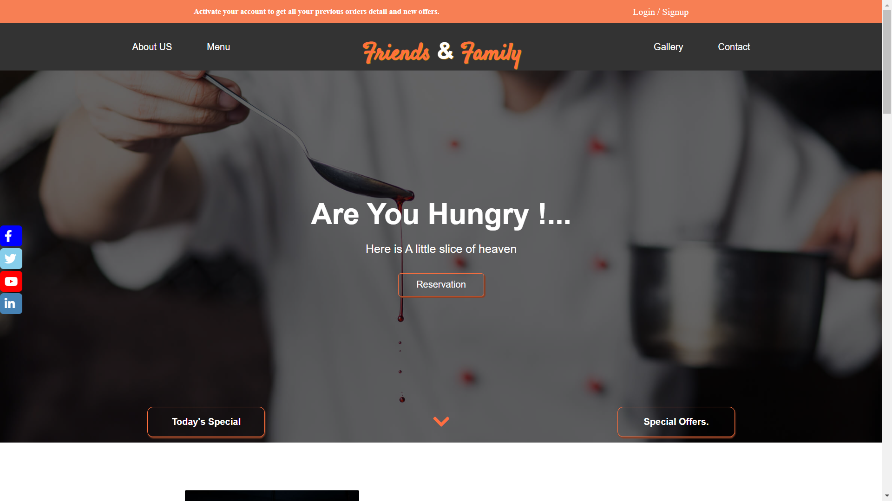
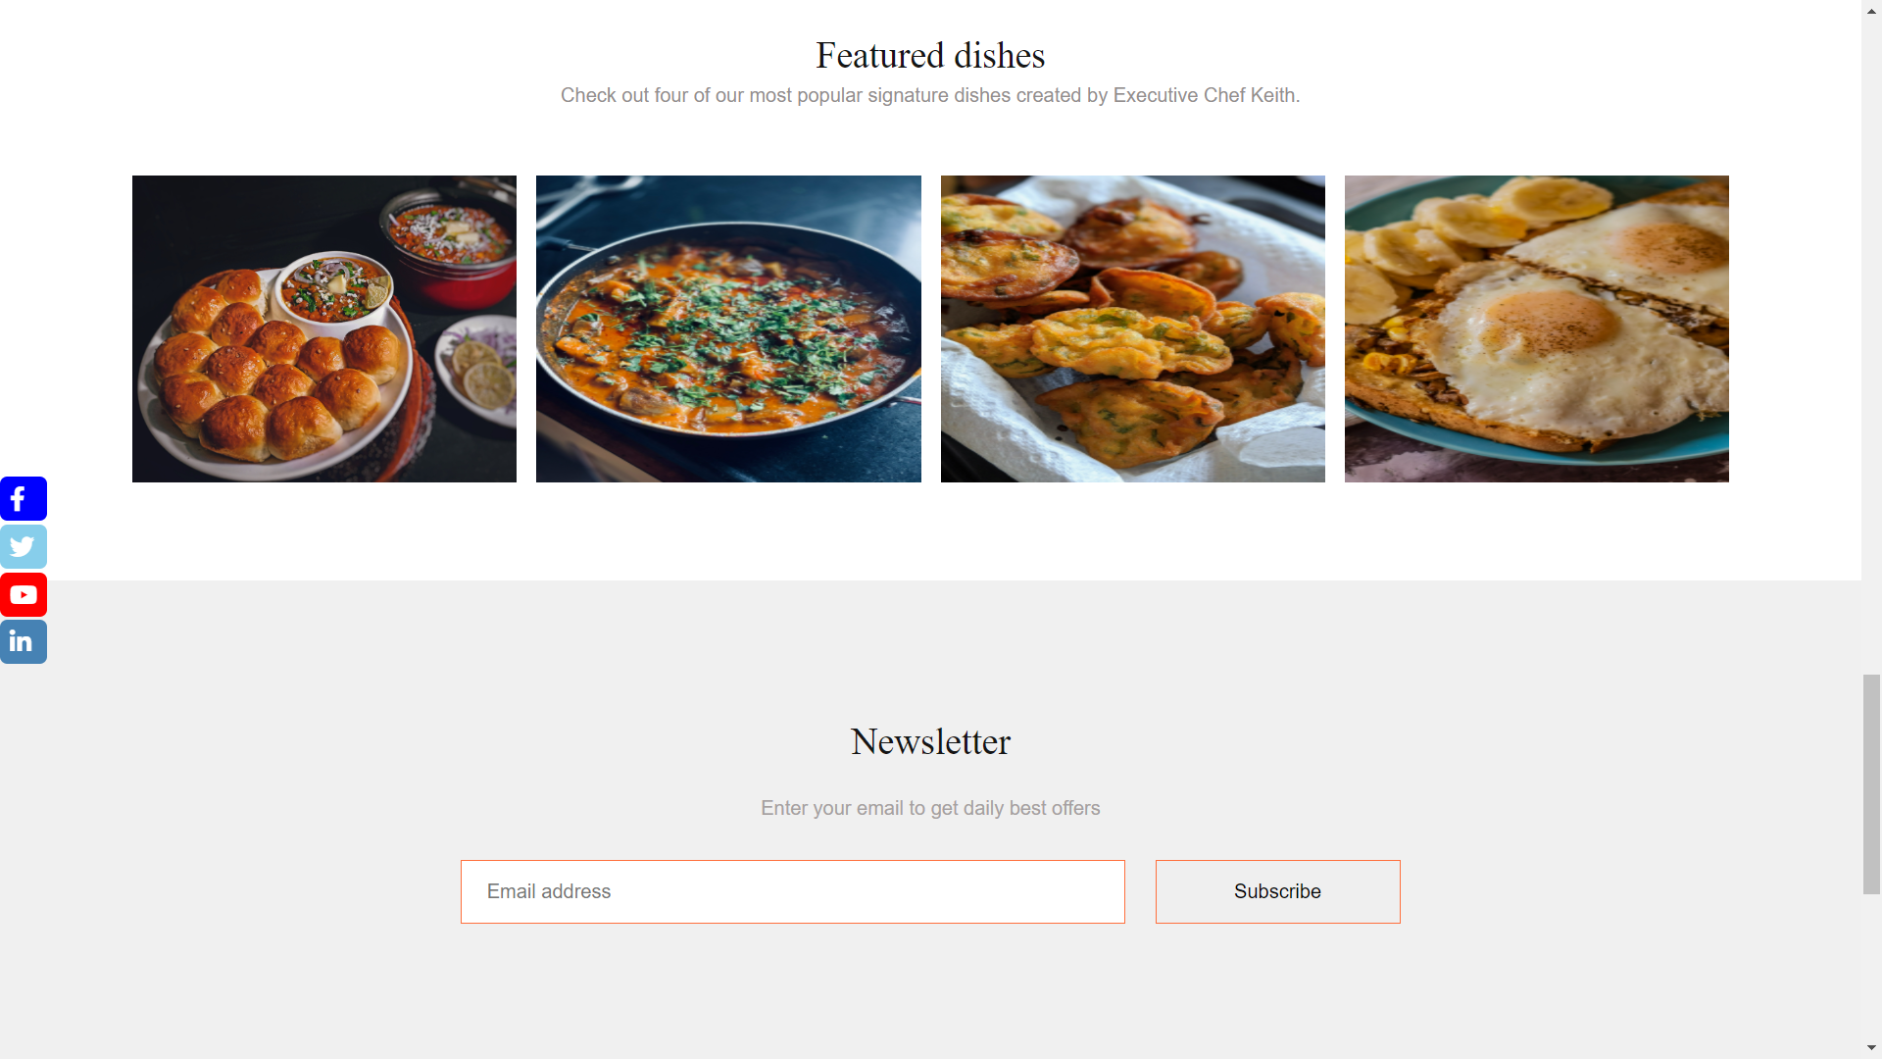
HOME PAGE
This is the main webpage that contains all the information about the restaurant and hyperlinks to other utilities.

Slide 10
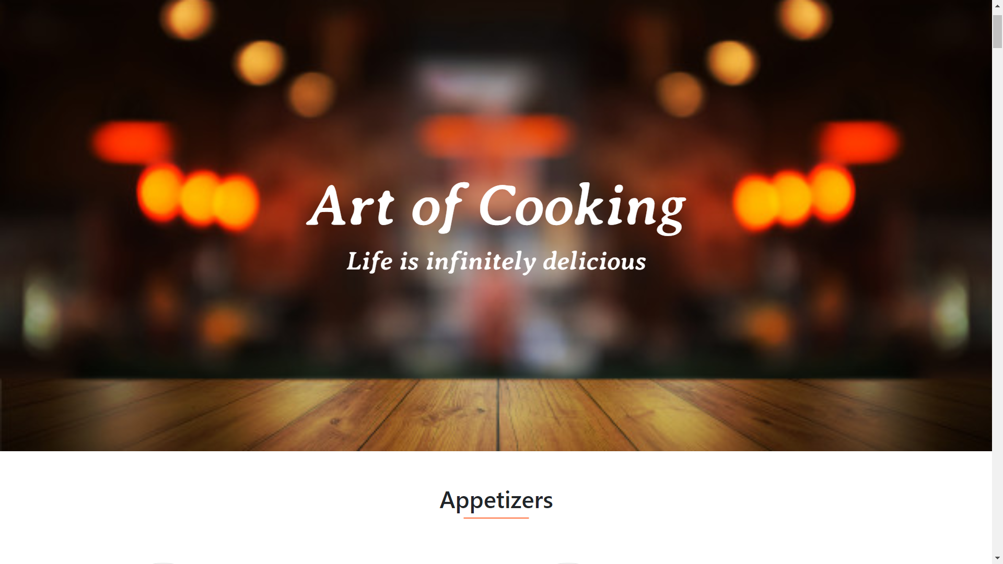
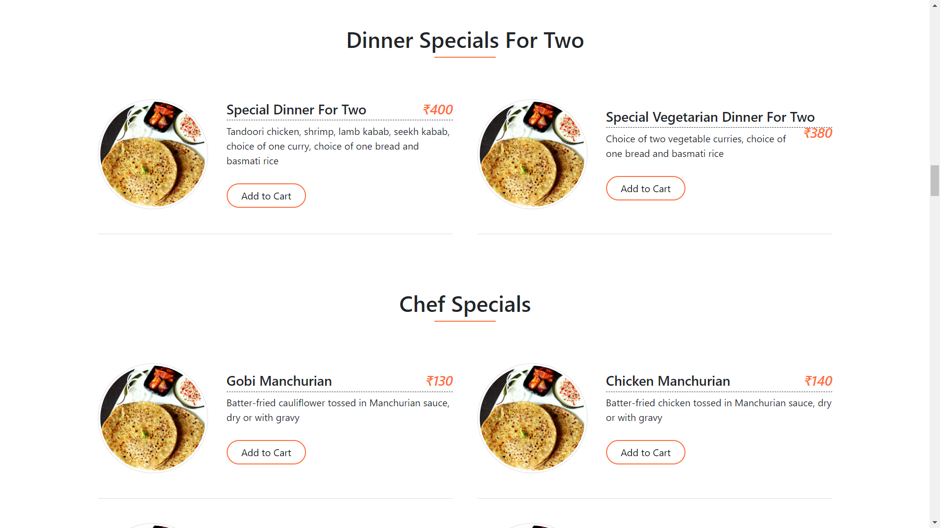
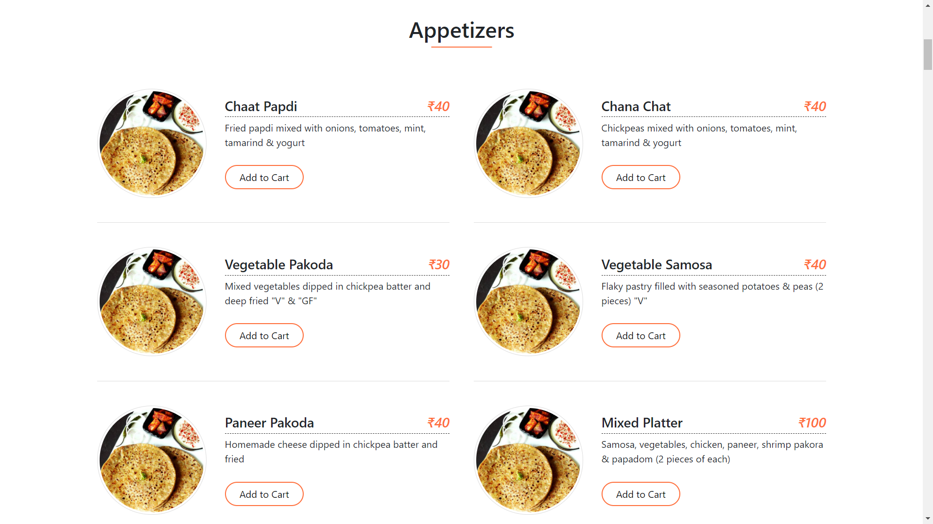
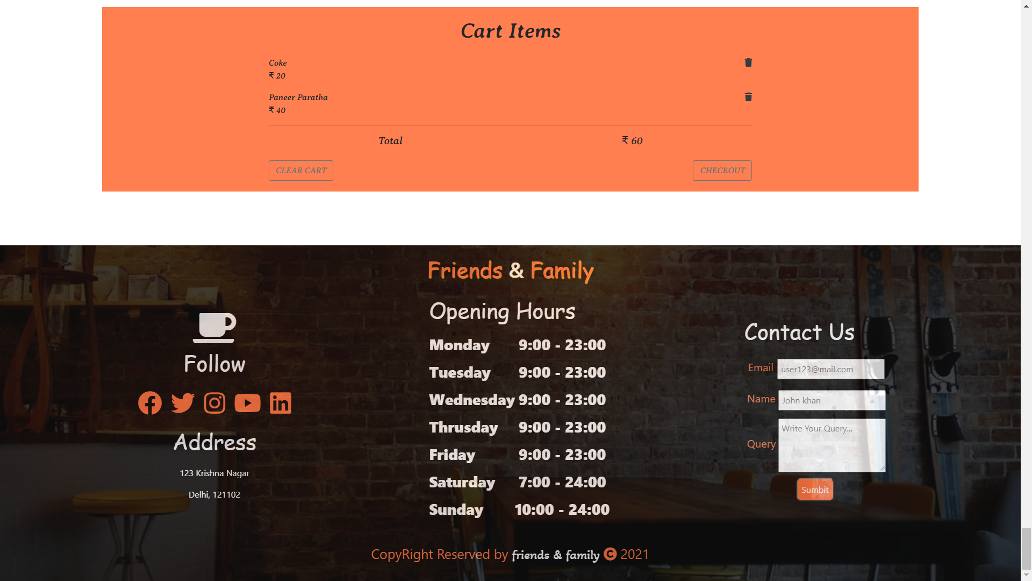
MENU PAGE
This is the webpage that contains all the information about the Food Menu,served by the restaurant and
also contains add to cart option.

Slide 11
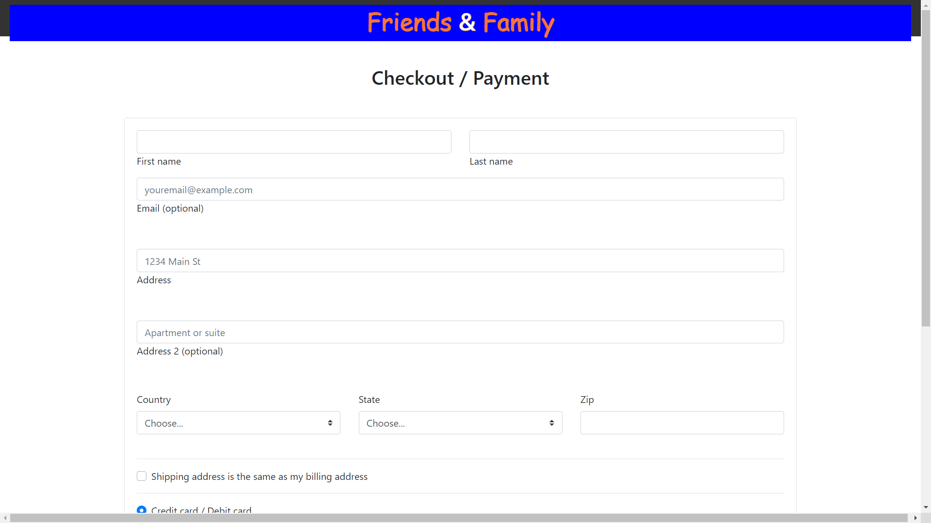
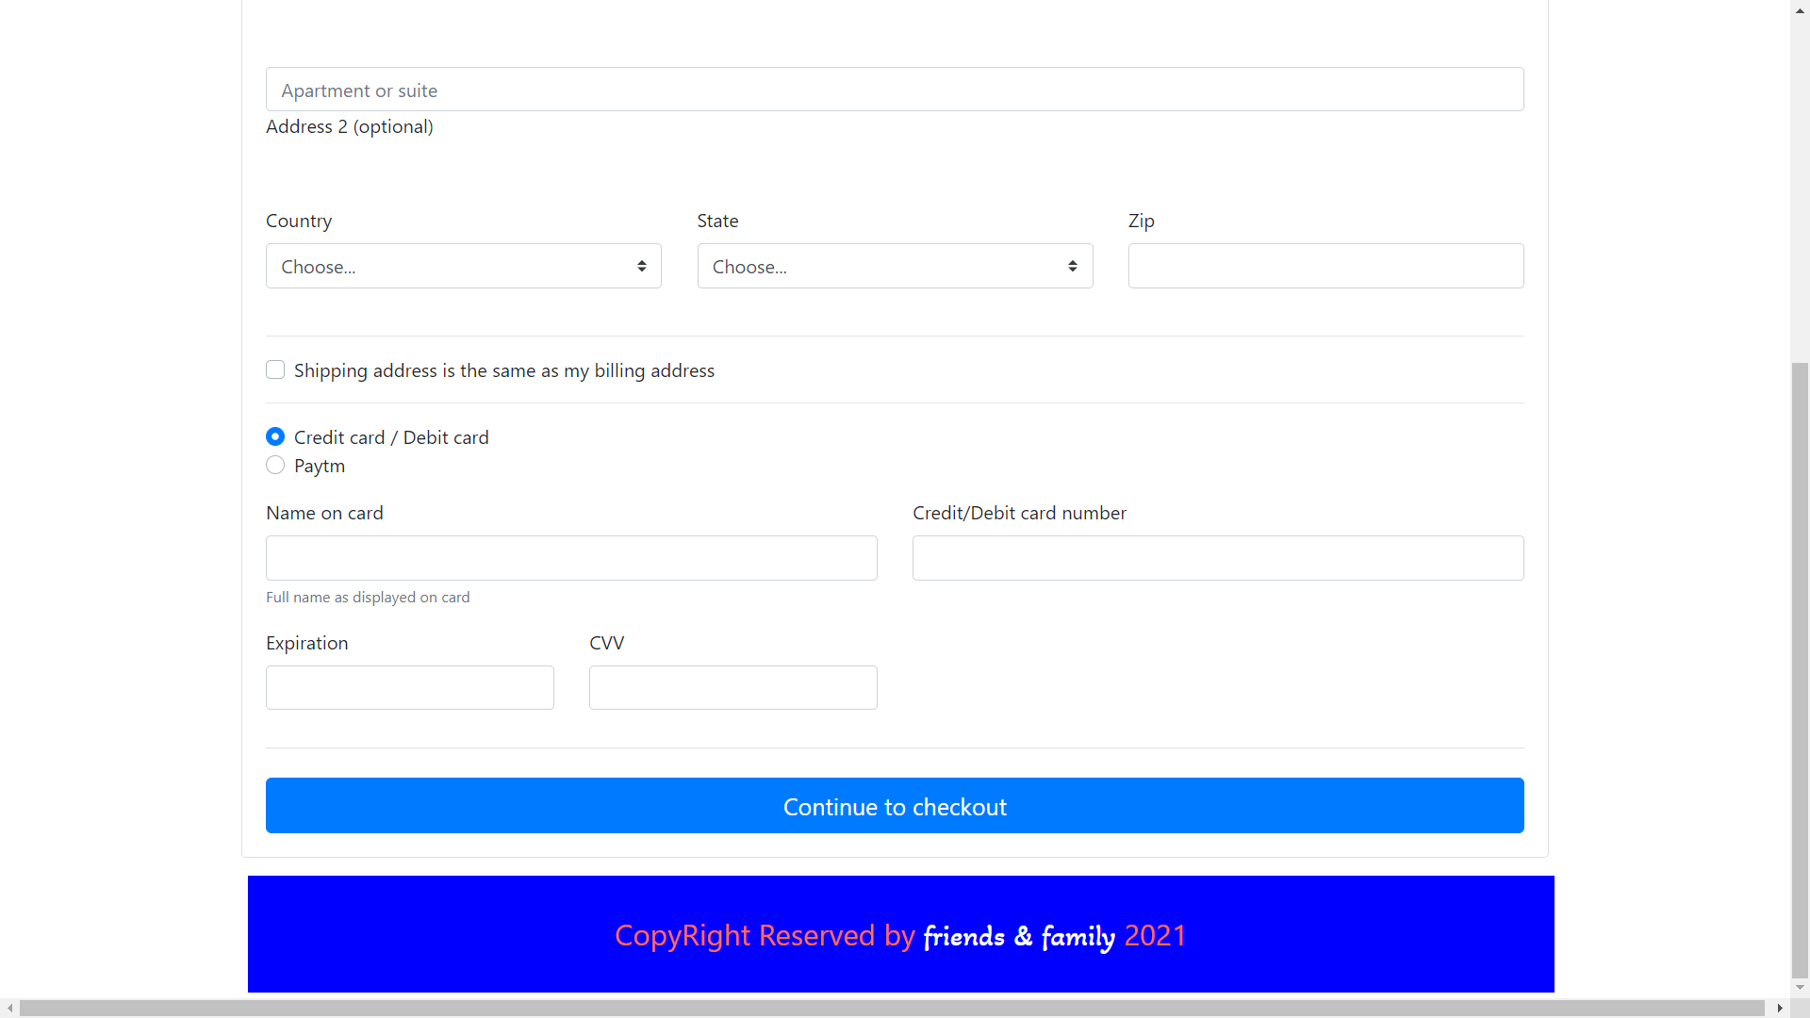
PAYMENTS PAGE
This is the webpage that is displayed to the user when he clicks on checkout button.

Slide 12
LANDING PAGE
This is the page first webpage that the user will see.

Slide 13
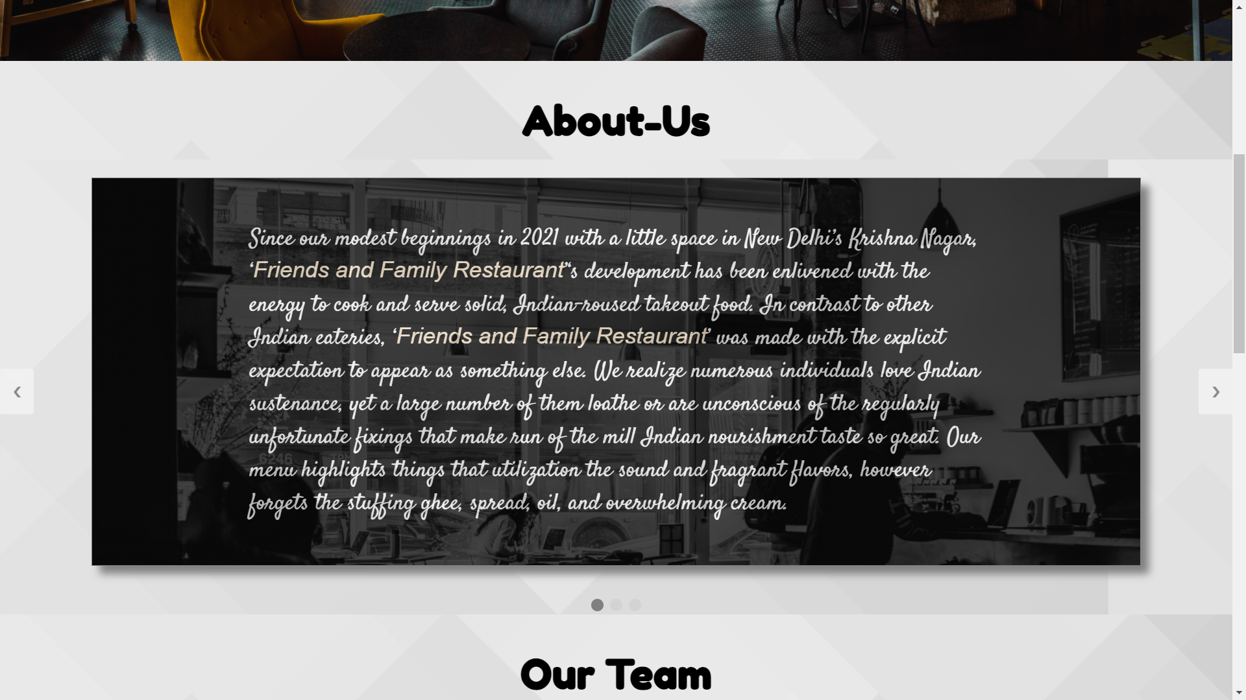
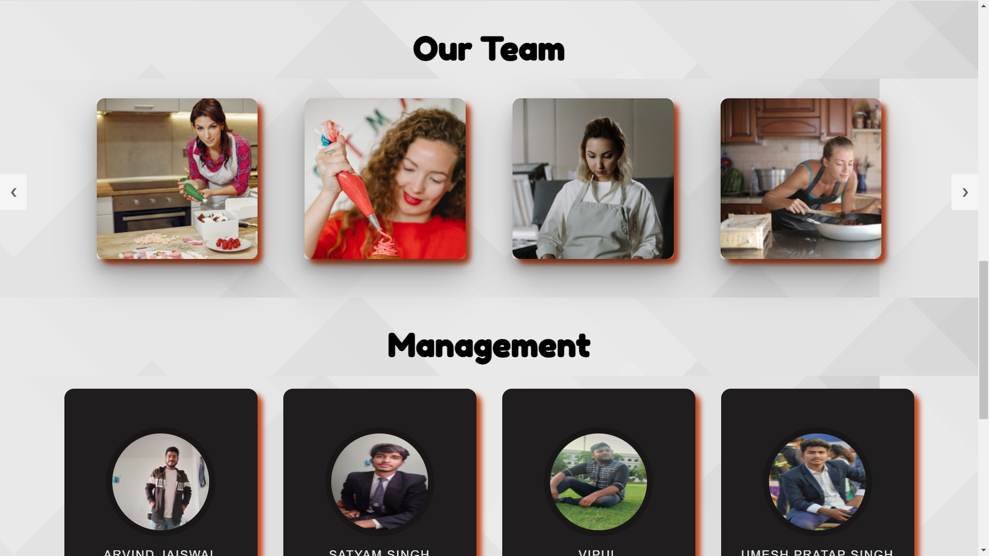
ABOUT US PAGE
This is the webpage that contains all the information about the restaurant establishmentshistory,management and staff.

Slide 14
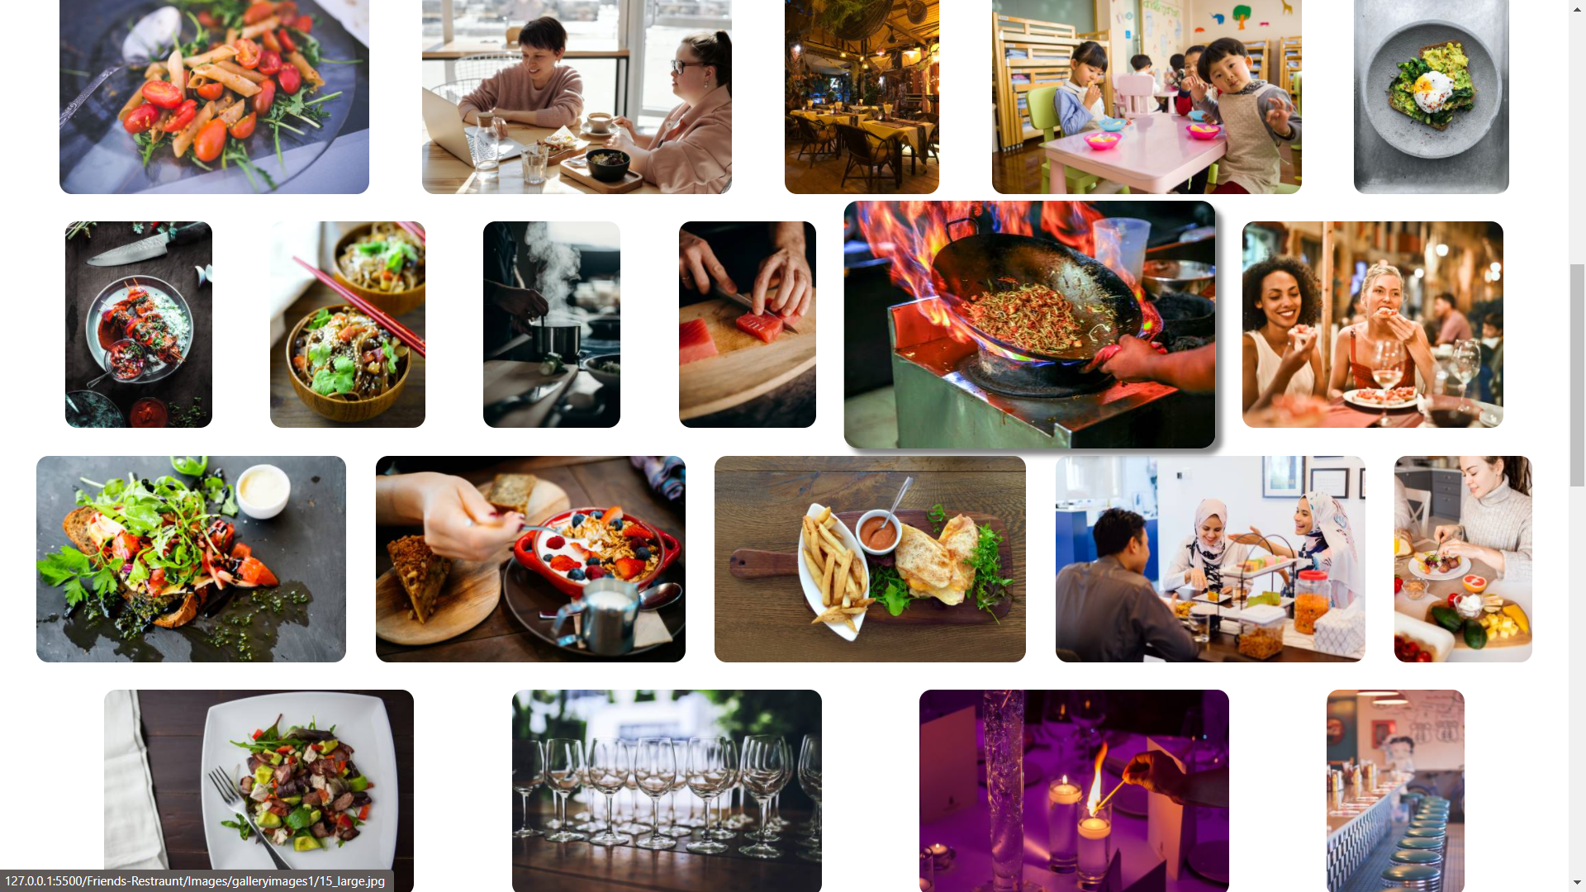
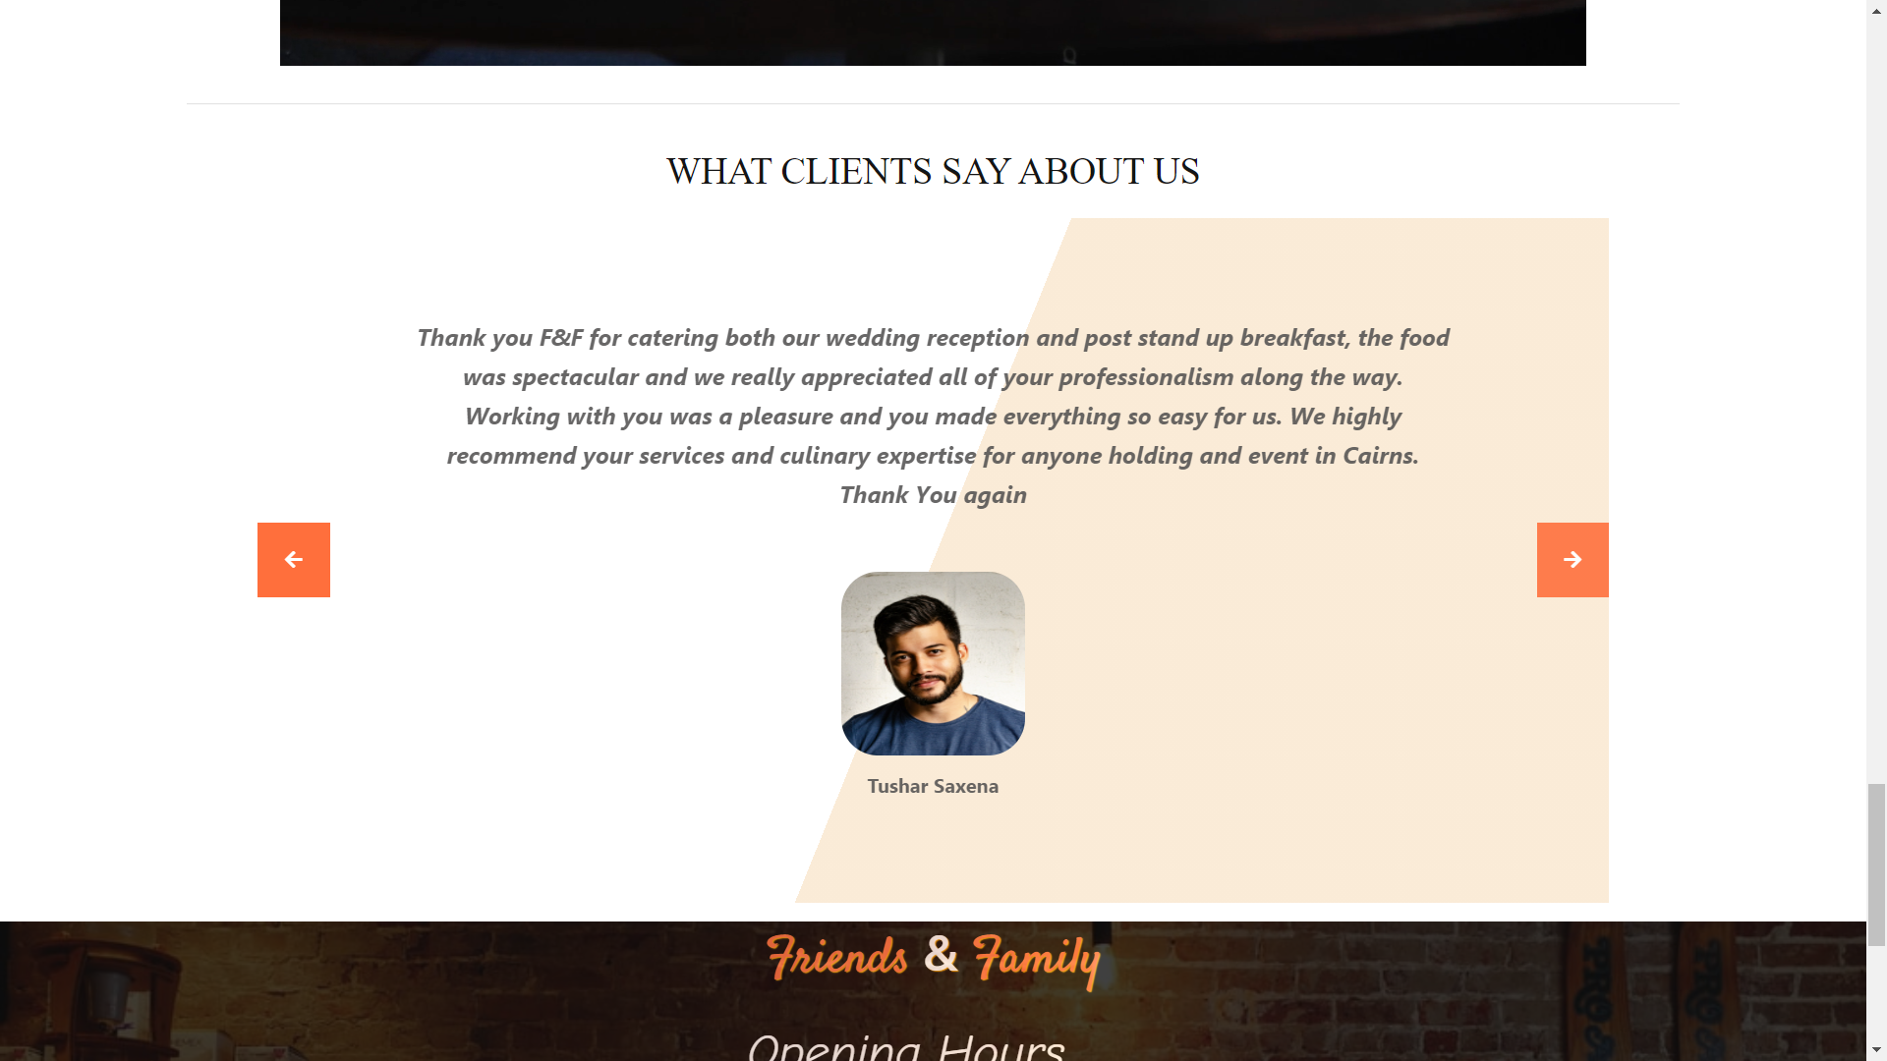
GALLERY PAGE
This is the webpage that contains ,many images of the restaurant , visitors and the food.Also it contains the visitors’ feedback.

Slide 15
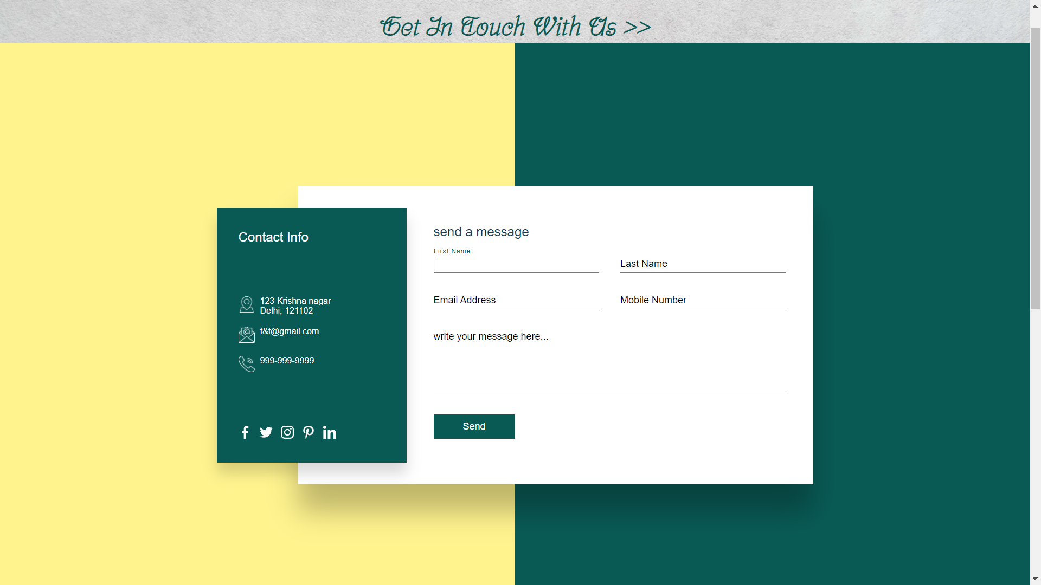
CONTACT PAGE
This is the webpage that contains contact information by which visitor can get assitance.

Slide 16
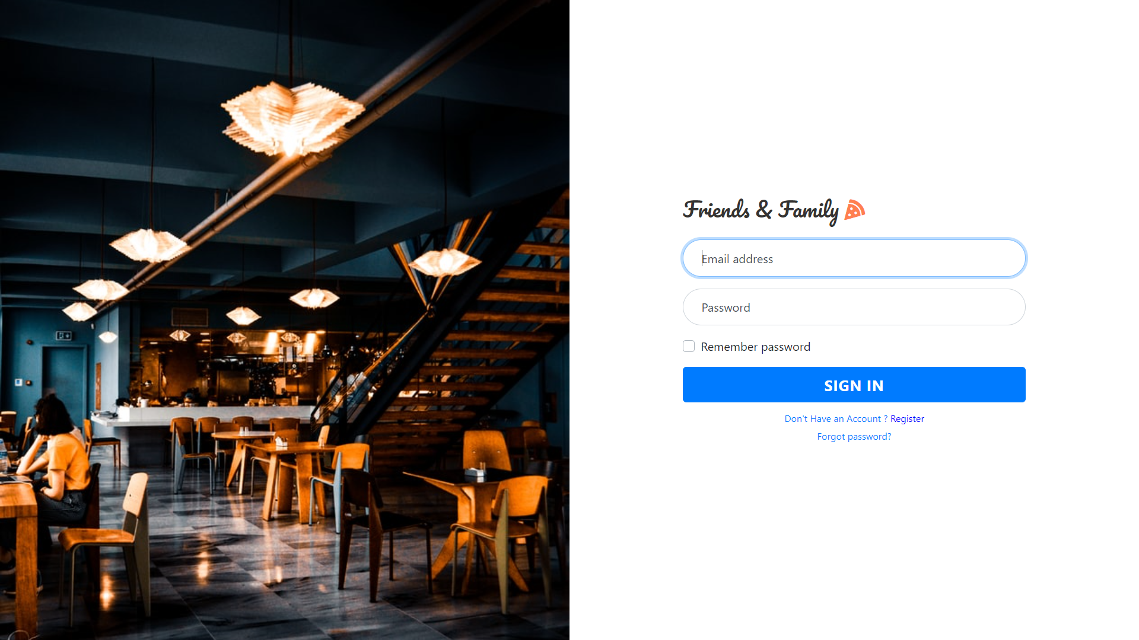
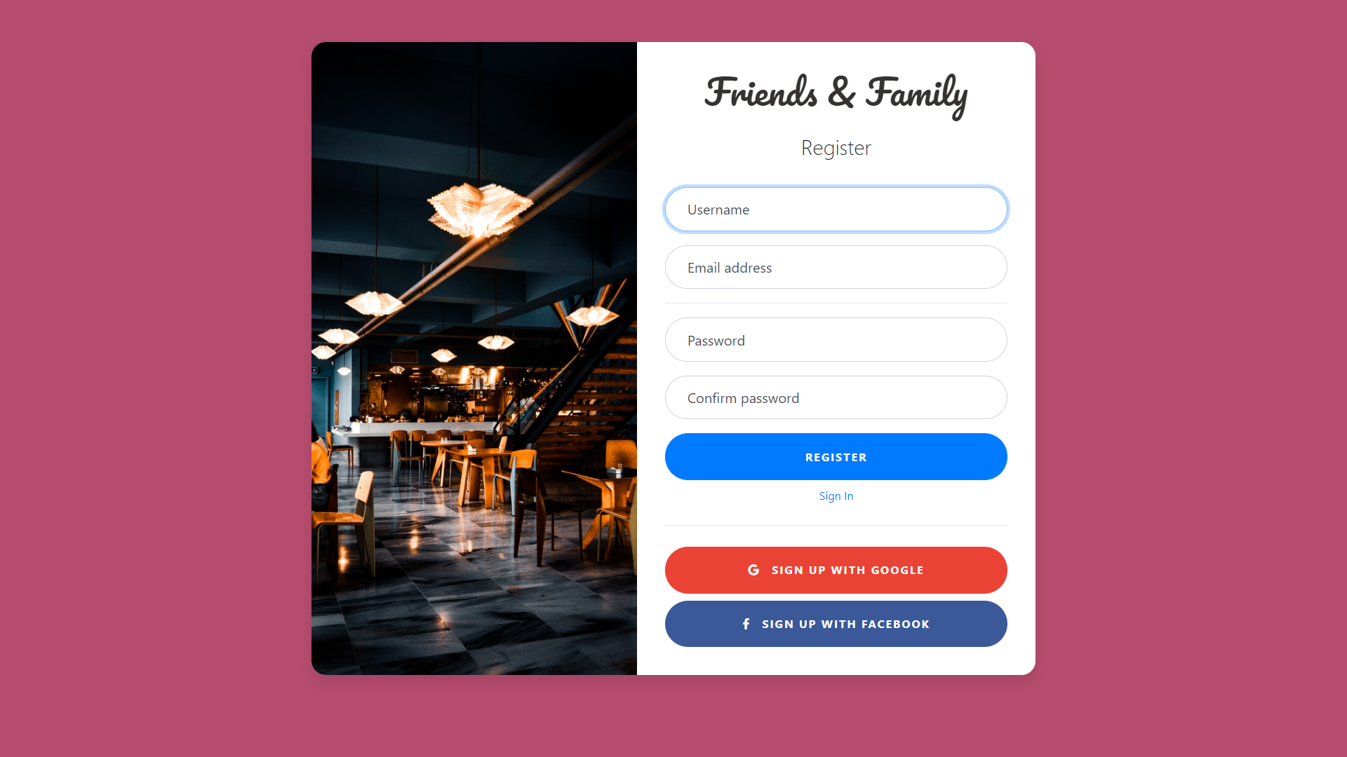
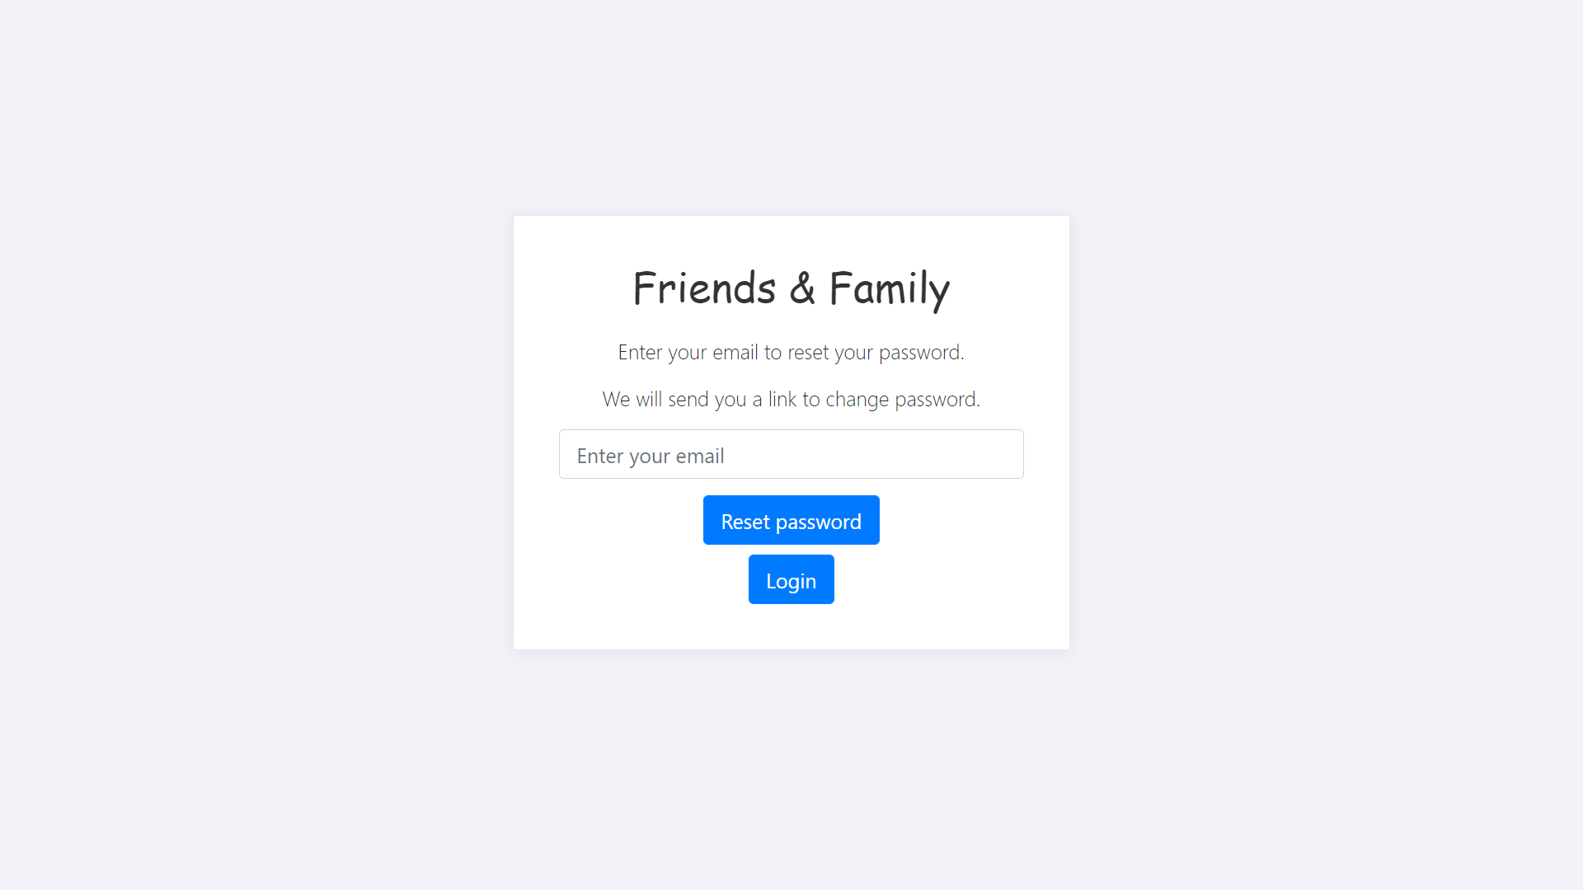
LOGIN/SIGNUP PAGE

Slide 17
REFERENCES
https://www.w3schools.com/
https://simpleqode.bitbucket.io/touche/index.html
https://github.com/vipulgupta22/Friends-Restraunt
https://vipulgupta22.github.io/Friends-Restraunt/.

Slide 18
REPOSITORY AND LINK
https://github.com/vipulgupta22/Friends-Restraunt
LIVE AT:
https://vipulgupta22.github.io/Friends-Restraunt/.

Slide 19
Thank You

